Slide 1








LineUp
Visual Analysis of Multi-Attribute Rankings
Samuel Gratzl
Marc Streit
Alexander Lex
Nils Gehlenborg
Hanspeter Pfister

Slide 2
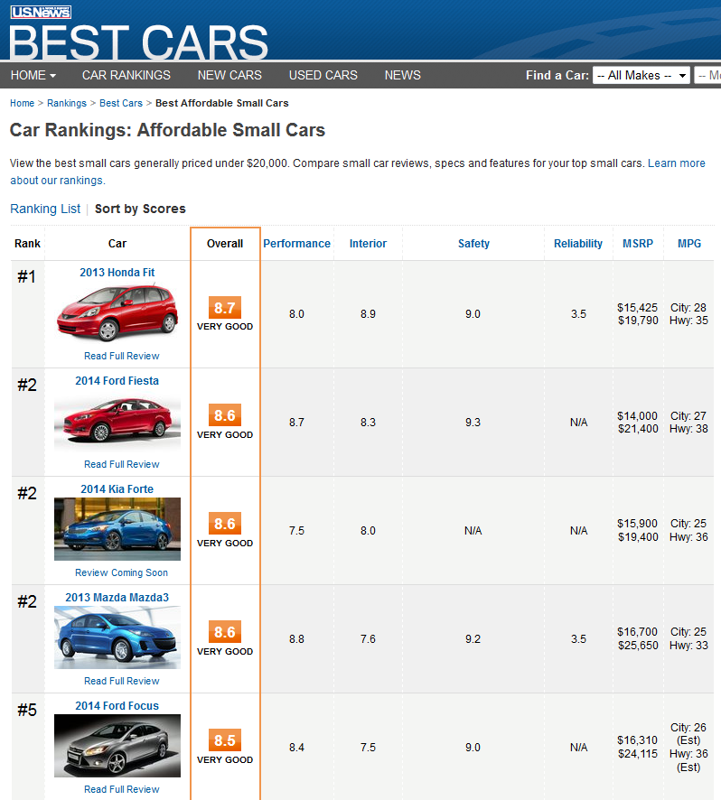
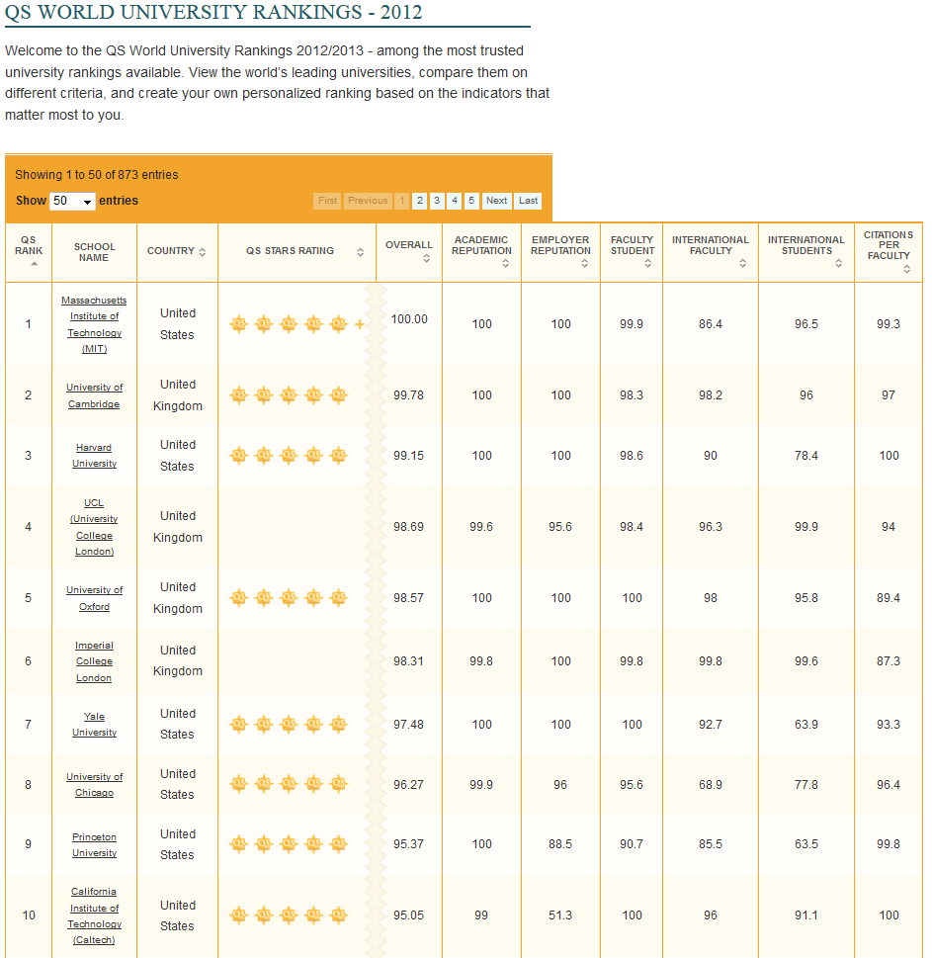
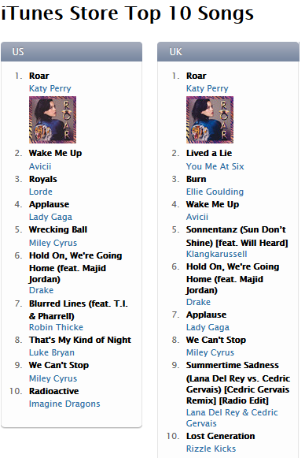
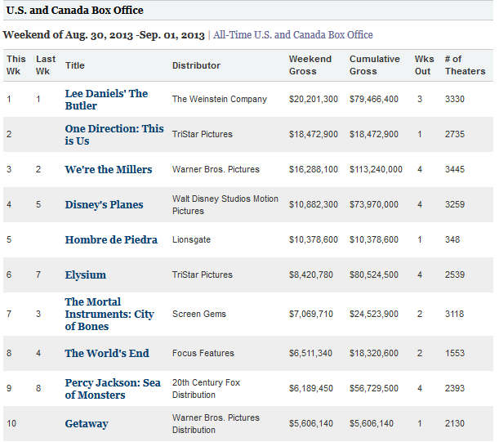
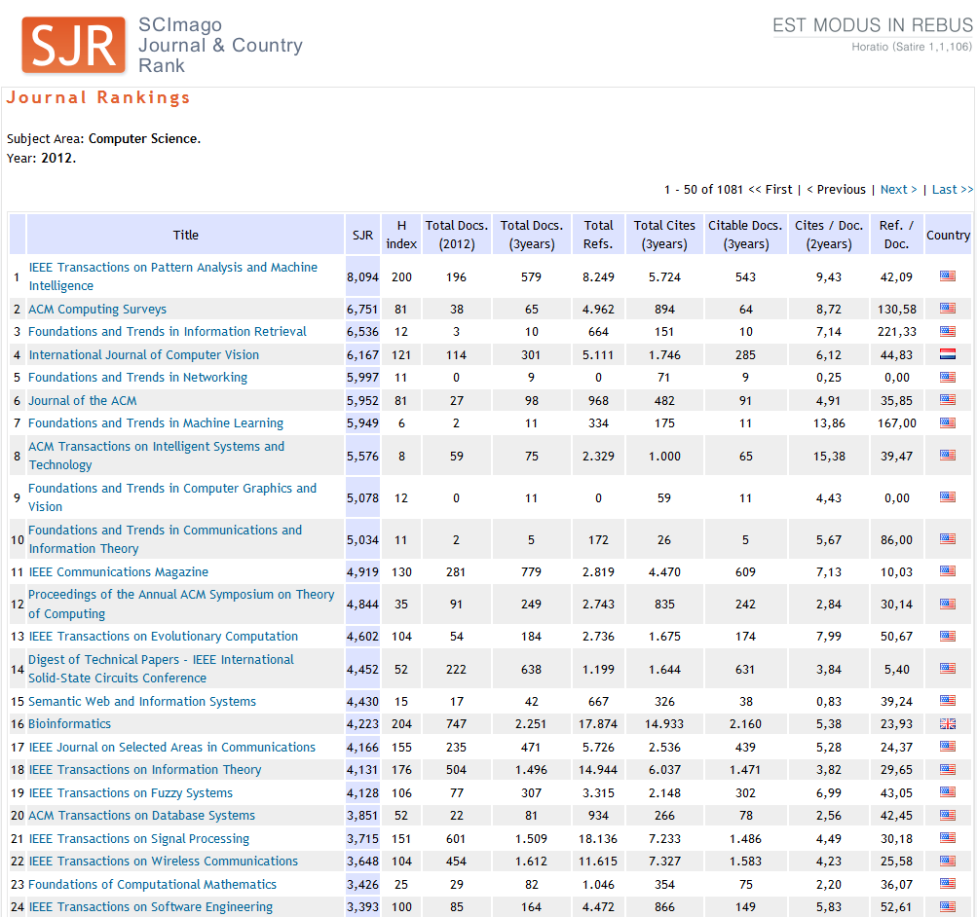
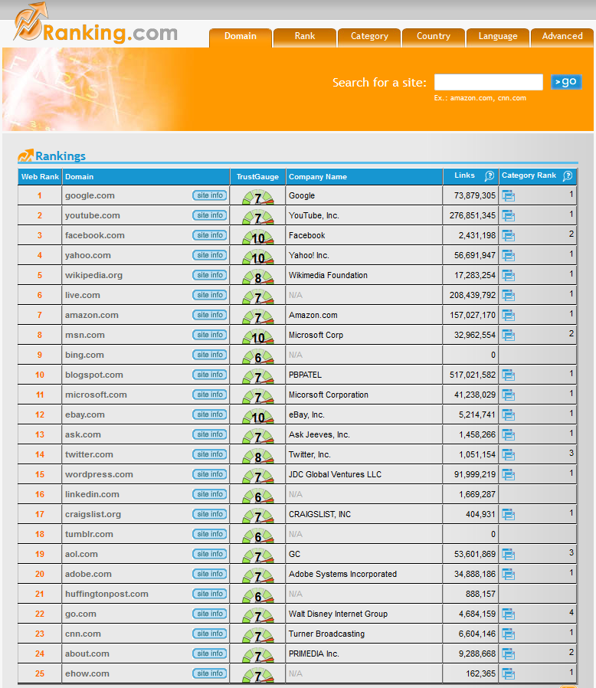

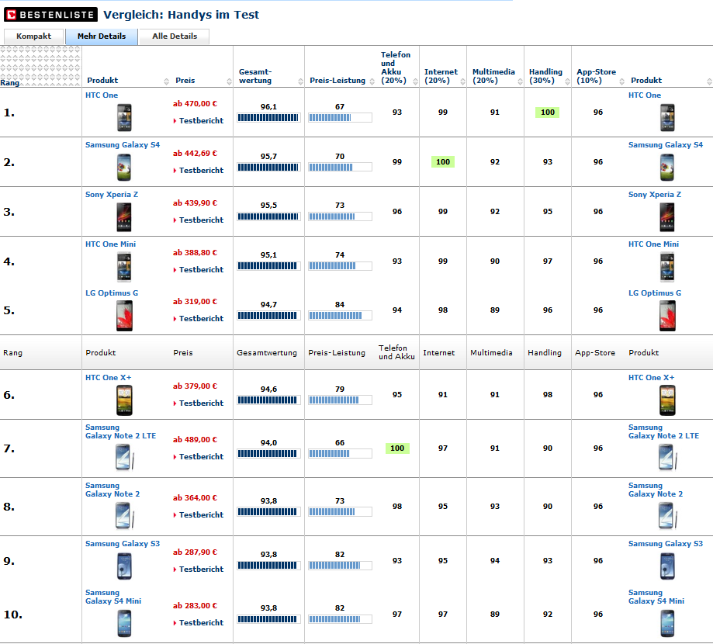
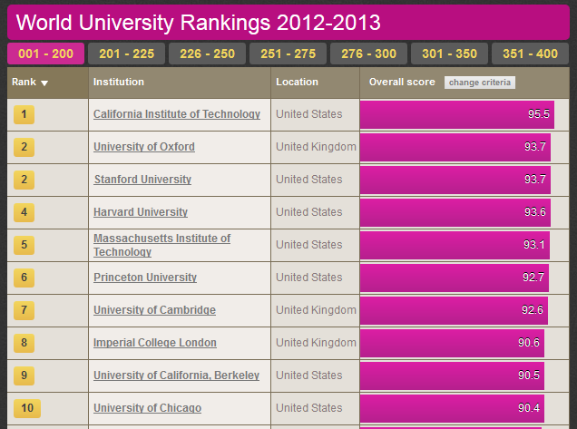

Rankings are omnipresent

Slide 3
Goal
Intuitive
Interactive
Multi-Attribute
Ranking Visualization
To Create
Refine
Explore

Slide 4
10 Requirements

Slide 5
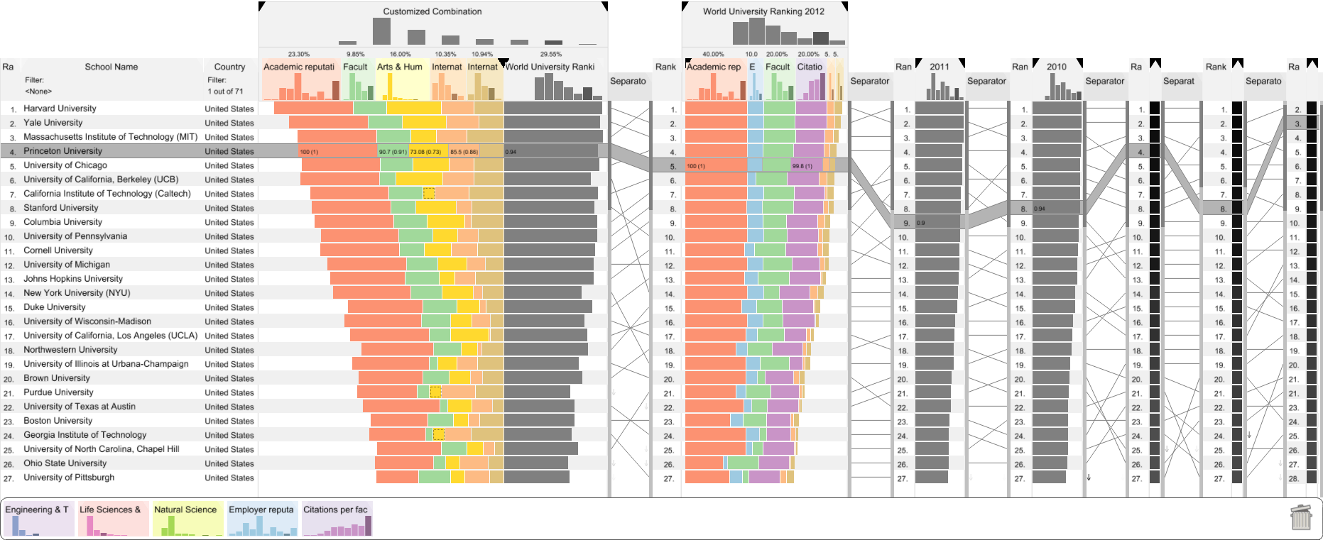
LineUp
“It’s really complex to make something simple…”
Jack Dorsey (creator of Twitter)

Slide 6


Slide 7
University
MIT, USA
Harvard, USA
Princeton, USA
Cambridge, UK
Oxford, UK

Slide 8
10 Requirements
Encode Rank
University
Encode Rank
MIT, USA
Harvard, USA
Princeton, USA
Cambridge, UK
Oxford, UK

Slide 9
10 Requirements
Encode Rank
University
Encode Rank
MIT, USA
Harvard, USA
Princeton, USA
Cambridge, UK
Oxford, UK

Slide 10
Rank
University
1.
MIT, USA
2.
Harvard, USA
3.
Princeton, USA
4.
Cambridge, UK
5.
Oxford, UK

Slide 11
10 Requirements
Encode Rank
Encode Cause of Rank
Rank
University
Encode Cause of Rank
1.
MIT, USA
2.
Harvard, USA
3.
Princeton, USA
4.
Cambridge, UK
5.
Oxford, UK

Slide 12
10 Requirements
Encode Rank
Encode Cause of Rank
Rank
University
Encode Cause of Rank
1.
MIT, USA
2.
Harvard, USA
3.
Princeton, USA
4.
Cambridge, UK
5.
Oxford, UK

Slide 13
Rank
University
Score
Score
1.
MIT, USA
89.4
2.
Harvard, USA
84.2
3.
Princeton, USA
73.8
4.
Cambridge, UK
64.3
5.
Oxford, UK
44.0

Slide 14
10 Requirements
Encode Rank
Encode Cause of Rank
Support Multiple Attributes
Rank
University
Score
Support Multiple Attributes
1.
MIT, USA
2.
Harvard, USA
3.
Princeton, USA
4.
Cambridge, UK
5.
Oxford, UK

Slide 15
10 Requirements
Encode Rank
Encode Cause of Rank
Support Multiple Attributes
Rank
University
Score
Support Multiple Attributes
1.
MIT, USA
2.
Harvard, USA
3.
Princeton, USA
4.
Cambridge, UK
5.
Oxford, UK

Slide 16
Score = f(A, B, C)
Rank
University
A
Score
B
C
1.
MIT, USA
2.
Harvard, USA
3.
Princeton, USA
4.
Cambridge, UK
5.
Oxford, UK

Slide 17
Combiner functions: f(A,B,C)
(Weighted) sum Score = w_{a} A + w_{b} B + w_{c} C
Maximum Score = max(A, B, C)
Product
Nesting
…
Serial
Parallel
Complex Combiners

Slide 18
Serial Combiner
(as Stacked Bar)
w_{a} A + w_{b} B + w_{c} C
Rank
University
A
B
C
1.
MIT, USA
2.
Harvard, USA
3.
Princeton, USA
4.
Cambridge, UK
5.
Oxford, UK

Slide 19
Serial Combiner
(as Stacked Bar)
w_{b} B
w_{c} C
w_{c} C
w_{a} A + w_{b} B + w_{c} C
w_{a} A
w_{a} A
+
w_{b} B
+
+
+
Rank
University
A
B
C
1.
MIT, USA
2.
Harvard, USA
3.
Princeton, USA
4.
Cambridge, UK
5.
Oxford, UK

Slide 20
Serial Combiner
(as Stacked Bar)
w_{b} B
w_{c} C
w_{a} A
+
+
Rank
University
A
B
C
1.
MIT, USA
2.
Harvard, USA
3.
Princeton, USA
4.
Cambridge, UK
5.
Oxford, UK

Slide 21
Parallel Combiner
(as Multi Bar)
Rank
University
A
MAX(A,B,C)
B
C
1.
MIT, USA
2.
Harvard, USA
3.
Princeton, USA
4.
Cambridge, UK
5.
Oxford, UK

Slide 22
Parallel Combiner
(as Multi Bar)
Rank
University
MAX(A,B,C)
1.
MIT, USA
2.
Harvard, USA
3.
Princeton, USA
4.
Cambridge, UK
5.
Oxford, UK

Slide 23
Parallel Combiner
(as Multi Bar)
Rank
University
MAX(A,B,C)
1.
MIT, USA
2.
Harvard, USA
3.
Princeton, USA
4.
Cambridge, UK
5.
Oxford, UK

Slide 24
Parallel Combiner
10 Requirements
Encode Rank
Encode Cause of Rank
Support Multiple Attributes
Interactive Refinement and Feedback
Rank
University
MAX(A,B,C)
Interactive Refinement and Visual Feedback
1.
Oxford, UK
2.
Harvard, US
3.
MIT, US
4.
Princeton, US
5.
Cambridge, UK

Slide 25
Parallel Combiner
10 Requirements
Encode Rank
Encode Cause of Rank
Support Multiple Attributes
Interactive Refinement and Visual Feedback
Rank
University
MAX(A,B,C)
Interactive Refinement and Visual Feedback
1.
Oxford, UK
2.
Harvard, US
3.
MIT, US
4.
Princeton, US
5.
Cambridge, UK

Slide 26
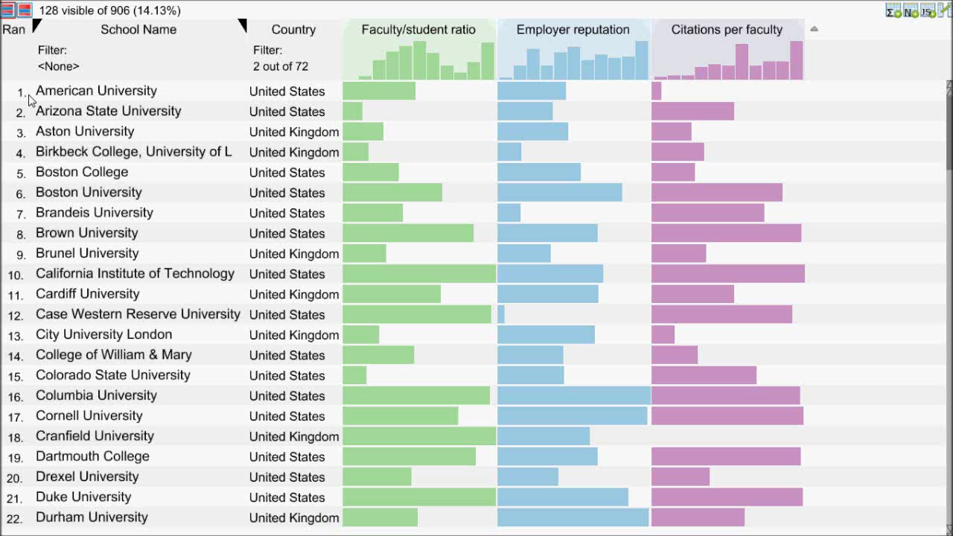
Video showing
Creating combined score
Sort by that
Change weights
Focus on animation: color & style

Slide 27
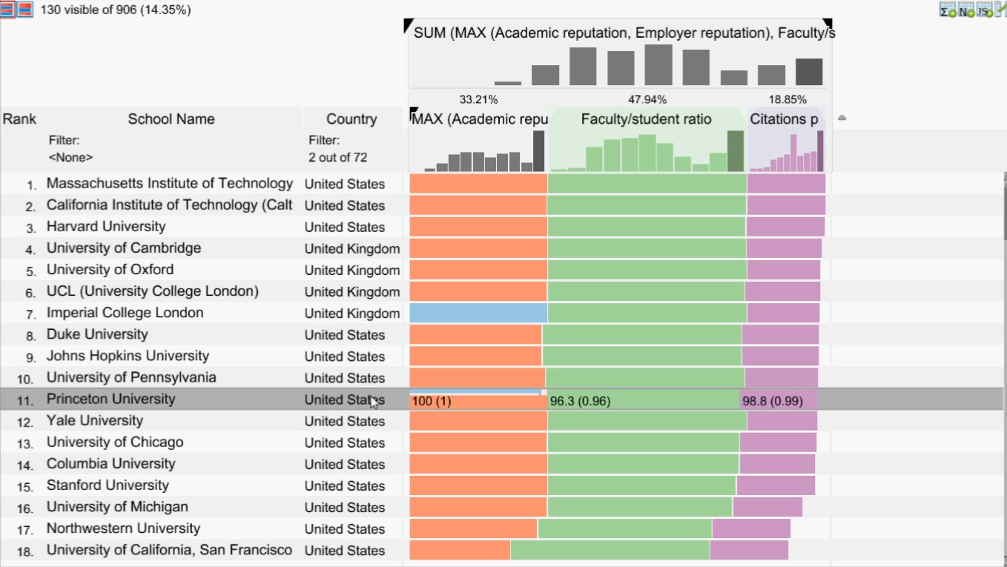
10 Requirements
Video showing
Creating combined score
Sort by that
Change weights
Focus on animation: color & style
Encode Rank
Encode Cause of Rank
Support Multiple Attributes
Interactive Refinement and Visual Feedback
Flexible Mapping of Attributes to Scores
Flexible Mapping of Attributes to Scores

Slide 28
10 Requirements
Video showing
Creating combined score
Sort by that
Change weights
Focus on animation: color & style
Flexible Mapping of Attributes to Scores
Encode Rank
Encode Cause of Rank
Support Multiple Attributes
Interactive Refinement and Visual Feedback
Flexible Mapping of Attributes to Scores

Slide 29
0
1
Max
Min
100
0

Slide 30
0
1
0
100

Slide 31
0
1
0
100

Slide 32
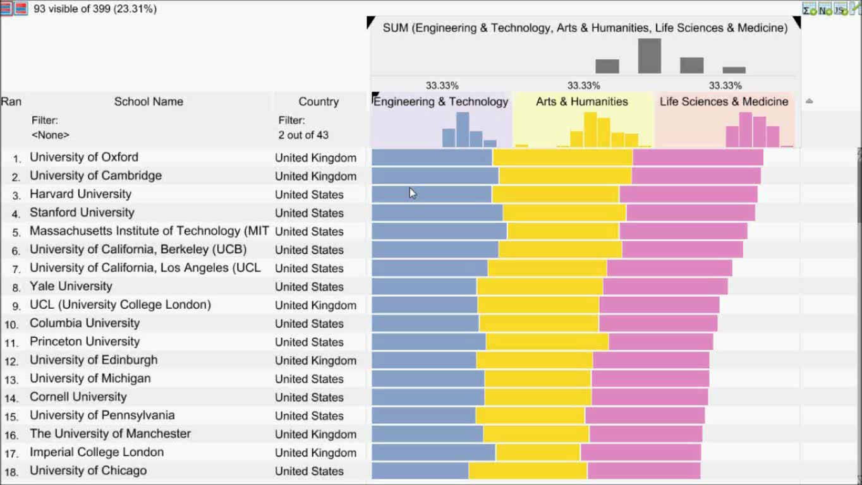
Video showing:
Scenario, manpulate mapping of attribute
Switch between two mode: hor / par
Add move points
Show java script editor
Apply A default one -> argument for compare

Slide 33
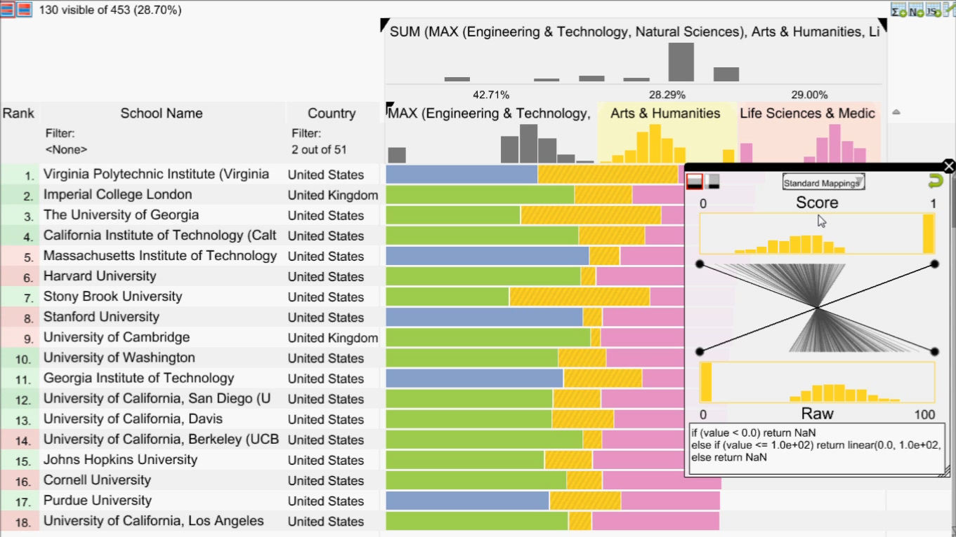
10 Requirements
Video showing
Creating combined score
Sort by that
Change weights
Focus on animation: color & style
Encode Rank
Encode Cause of Rank
Support Multiple Attributes
Interactive Refinement and Visual Feedback
Flexible Mapping of Attributes to Scores
Compare Rankings
Compare Rankings

Slide 34
10 Requirements
Video showing
Creating combined score
Sort by that
Change weights
Focus on animation: color & style
Encode Rank
Encode Cause of Rank
Support Multiple Attributes
Interactive Refinement and Visual Feedback
Flexible Mapping of Attributes to Scores
Compare Rankings
Compare Rankings

Slide 35
Bump Charts
Rank
University
Score
Rank
Score
Score
1.
MIT, USA
1.
2.
Harvard, USA
2.
(+1)
3.
Princeton, USA
3.
(+1)
4.
Cambridge, UK
4.
(-2)
5.
Oxford, UK
5.

Slide 36
Bump Charts
Rank
University
Score
Rank
Score
Score
1.
MIT, USA
1.
2.
Harvard, USA
2.
2.
Harvard, USA
(+1)
3.
Princeton, USA
3.
(+1)
4.
Cambridge, UK
4.
4.
(-2)
(-2)
5.
Oxford, UK
5.

Slide 37
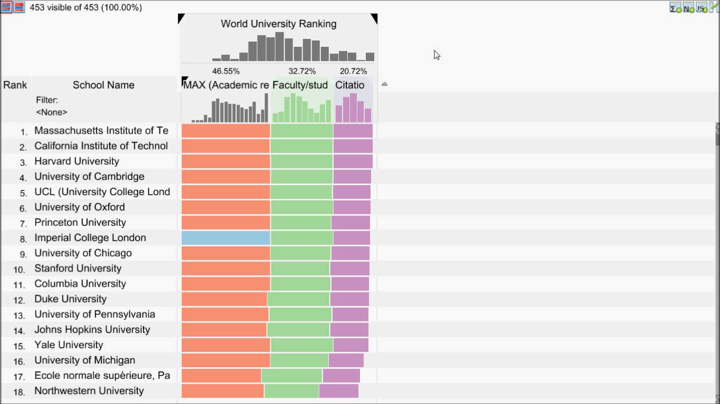

Slide 38
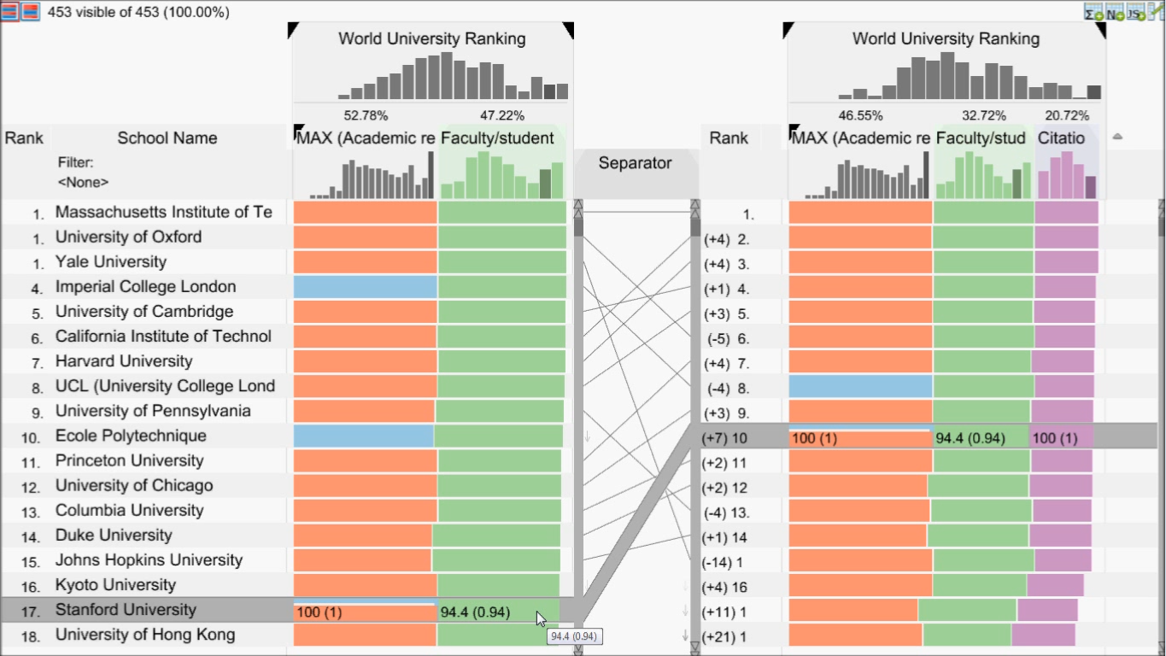
10 Requirements
Encode Rank
Encode Cause of Rank
Support Multiple Attributes
Interactive Refinement and Visual Feedback
Flexible Mapping of Attributes to Scores
Scalability
Compare Rankings
Scalability

Slide 39
10 Requirements
Encode Rank
Encode Cause of Rank
Support Multiple Attributes
Interactive Refinement and Visual Feedback
Flexible Mapping of Attributes to Scores
Scalability
Compare Rankings
Scalability

Slide 40
Scalability
Rank
University
Score
A
B
C
1.
MIT, USA
2.
Harvard, USA
3.
Oxford, UK
4.
Cambridge, UK
5.
Princeton, USA

Slide 41
10 Requirements
Encode Rank
Encode Cause of Rank
Support Multiple Attributes
Interactive Refinement and Visual Feedback
Flexible Mapping of Attributes to Scores
Compare Rankings
Scalability
Filtering
Handle Missing Values
Optimization

Slide 42
Optimization
Rank
University
A
B
C
Multi-objective Optimization
(MOO)
1.
MIT, USA
2.
Harvard, USA
3.
Oxford, UK
4.
Cambridge, UK
5.
Princeton, USA

Slide 43


Implementation
Open source (BSD 3)
Source code on GitHub: https://github.com/Caleydo
Demos, videos, and more: http://lineup.caledyo.org
http://caleydo.org

Slide 44
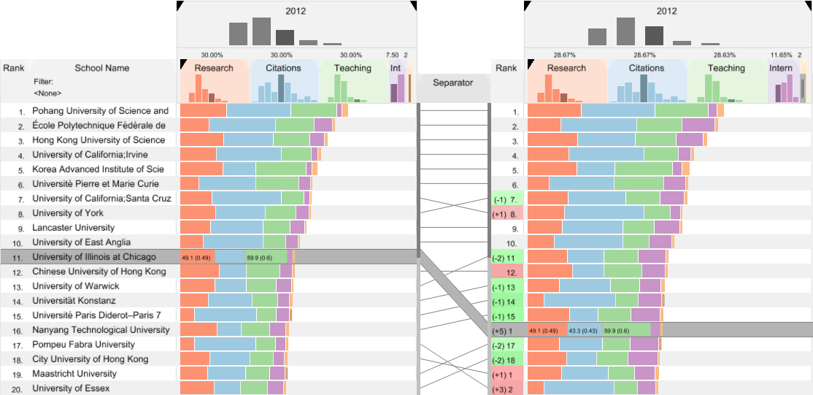
Summary
10 requirements for an intuitive interactive multi-attribute ranking tool
LineUp visualization technique
Future Work
Web port
Integrate optimization algorithms

Slide 45
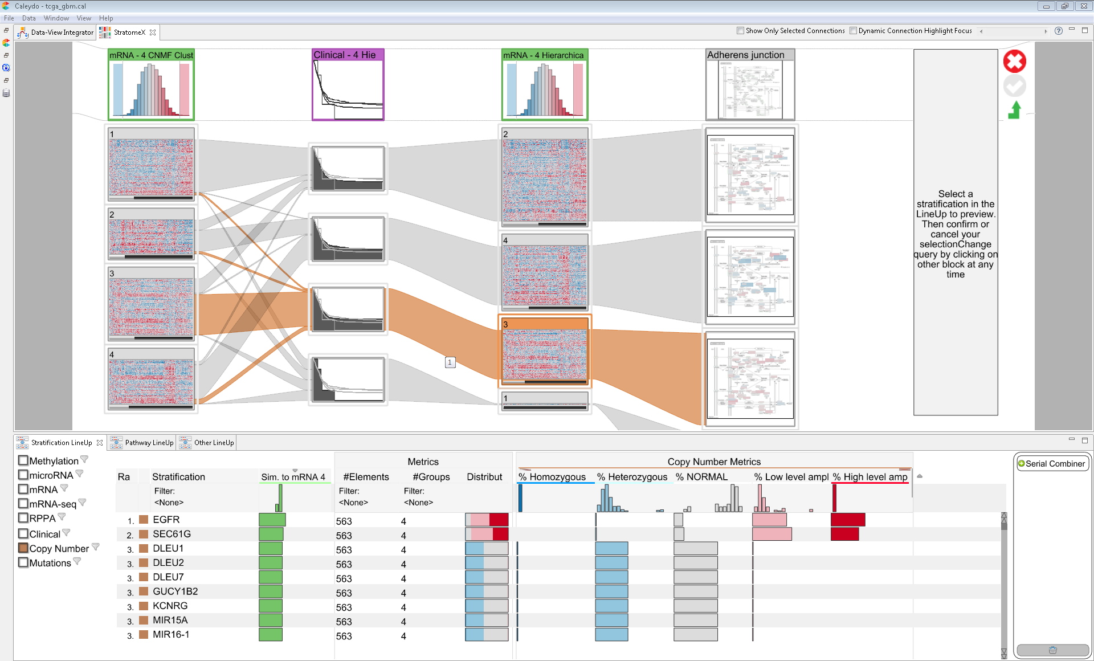
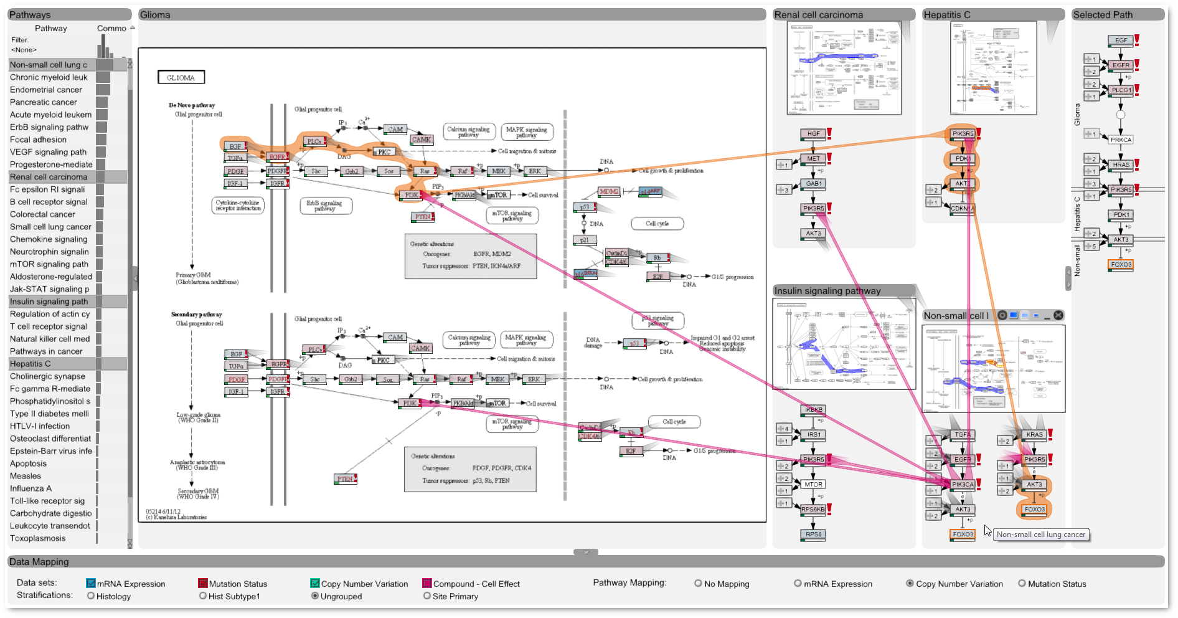
LineUp Applications
Thursday
Session: Application Areas 10:30 am - 12:10 pm, Ballroom A
StratomeX Cancer Subtype Analysis
Entourage Pathway Analysis

Slide 46
LineUp
Visual Analysis of Multi-Attribute Rankings
?
Samuel Gratzl, Alexander Lex, Nils Gehlenborg, Hanspeter Pfister, and Marc Streit
samuel.gratzl@jku.at
http://lineup.caleydo.org

